Slide 1
Social Engineering Denial of Service
Security fall 2018

Slide 2
Social Engineering principles
Reprocity
People tend to return a favour (good cop/bad cop)
Commitment and consistency
Brainwashing – ”I’ll sign up later” vs. ”No thanks I prefer not making money”

Slide 3
Social Engineering principles
Social proof
The others do so
Authority
Linking
What would others do or think
Scarity
Limited time

Slide 4
Social Engineering vectors
Vishing
Voice phishing
Phishing
Homophone for fishing
Spear phishing uses highly customized content
Water holing uses knowledge about favourite sites
Smishing
SMS phishing
Impersonation

Slide 5
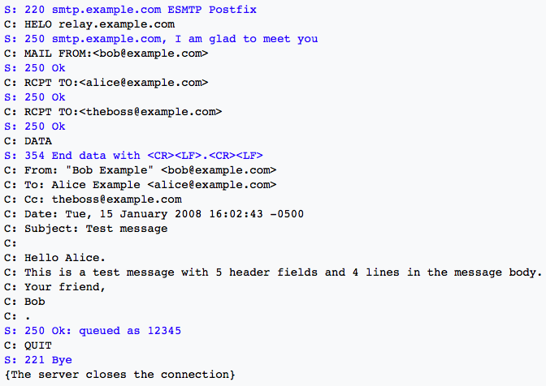
SMTP

Slide 6
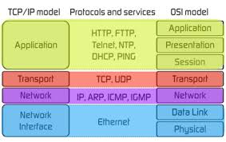
Denial of Service
Crash Service
Flood Service
Distributed attacks
Application layer attacks
Network layer attacks

Slide 7
Denial of Service DoS
Degradation of Service
Denial of Service Level II
Make the service block as a defense mechanism
Distributed Denial of Service DDoS
HTTP POST DoS attack
Internet Control Message Protocol Attack
Permanent DoS attacks phlashing
Destroy Server e.g. By updating firmware

Slide 8
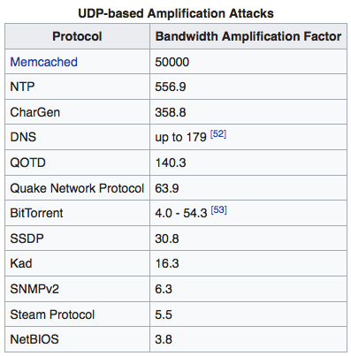
Denial of Service
Amplification

Slide 9
Denial of Service
Elastic cloud services
Blackholing – sinkholing
ISP based prevention
DoS Defense System (DDS) based defense
Firewalls
Routers
Upstream filtering

